Slide 1
Update to the NEMS Wind Model
Chris Namovicz
NEMS/AEO 2003 Conference
Washington, DC
March 18, 2003
cnamovicz@eia.doe.gov
202-586-7120
Notes:
My name is Chris Namovicz and I work at EIA developing the modeling and forecasting of wind and solar energy. I’m going to talk a bit about some recent changes I made to how NEMS treats wind.

Slide 2
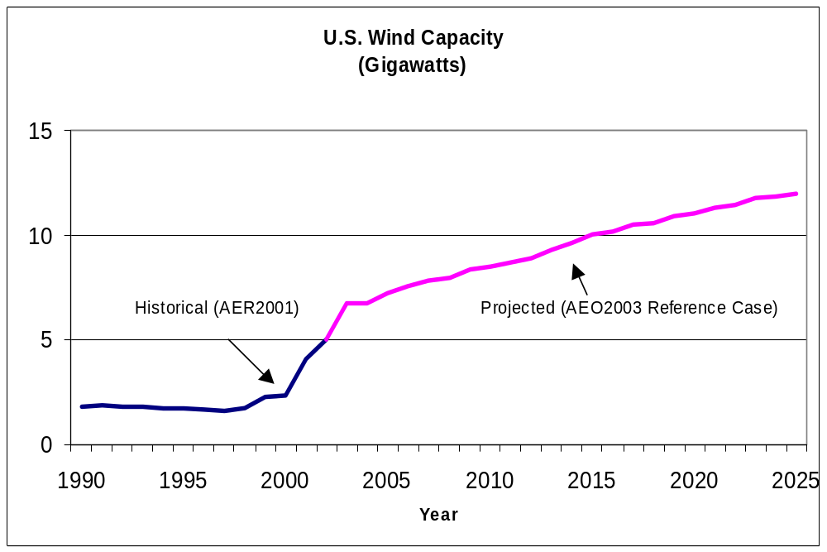
AEO2003 Wind Projection
Notes:
Wind power has expanded quite rapidly in the past five years as the result of several factors:
Improving economics
Federal-level subsidies such as the PTC
State-level mandates and incentives
Achieves 12 GW by 2025 from about 4.3 GW in 2001

Slide 3
Major Model Changes for Wind
Cost/impacts of intermittency
  Fixed limit on intermittent’s share of regional generation in AEO2002
  Flexible, cost-based approach in AEO2003
Learning for cost and performance
  Large capital cost reductions, fixed performance in AEO2002
  Small capital cost reductions, performance based on experience in AEO2003
Notes:
The two changes affect how NEMS models the costs of intermittent generator interaction with the grid, and how the fundamental cost declines of this resource are reflected in the model.
The intermittency changes apply to solar technologies as well, but wind is generally seen by the model as being more economic, I will generally talk about wind.

Slide 4
Intermittency: Background
Increased importance of wind in “high renewables” scenarios not reflected with fixed penetration limit
Penetration limit may not reflect gradual increase in “real-world” costs with penetration
  Costs are assumed “all or nothing”
  Simple representation of several complex interactions
Notes:
In the AEO2003 reference case, wind achieves 12 GW of total U.S. capacity by 2025, accounting for less than 1% of total generation.
However, in “high renewable” cases, such as renewable portfolio standards or carbon reduction cases, NEMS shows wind as being a significant contributor to electricity supply.
Intermittency refers to the uncontrolled and to a large extent uncertain availability of wind or solar power on the grid.
The existing approach for intermittents was adequate for scenarios where wind penetration was expected to be limited, but did not accurately reflect the increasing costs of integrating wind into the grid.
It assigned win virtually no integration cost until it stopped building altogether, even if some policy driver could have made the market willing to pay higher integration costs to obtain the zero-emission benefits of wind.
I wanted to develop a new approach that would better reflect some of the more complex market dynamics

Slide 5
AEO2002 Model Structures
Penetration limit
  10 to 15% of Regional Generation
  Applies to Solar and Wind, but only Wind is really affected
Capacity Credit
  75% of Regional Peak-load Capacity Factor
  Also applies to all intermittent technologies
Notes:
I identified two areas of NEMS that were being used to model the interaction of intermittent resources like wind with the grid.
The intermittent pentration limit, as noted previously, has ranged from 10 to 15% of regional generation, with the AEO2002 value being 12%, and the higher values generally used when looking at scenarios where wind would have exceptionally high value
The capacity credit is the fraction of the nameplate capacity of a generator allowed to contribute to the regional reserve margin requirement, which is the model parameter that ensures adequate, reliable generation in each region.
In AEO2002, wind was assigned a credit of 75% of it capacity factor during the peak load period.

Slide 6
Theoretical Basis
No present-day analogs for large, NERC-like regional systems
Recent studies examine ancillary services impacts
Existing market structures vary
  Some ISO’s do not allow “intermittent” resources to compete in capacity market, others assign partial capacity credit
  FERC does not want “arbitrary” penalties
Early studies provide some evidence
Notes:
I did some literature research and talked to several experts in the field to develop a better basis for reflecting the costs of intermittency on the grid.
These effects are generally seen at higher penetrations than currently seen. Although some utility systems, such as Denmark and parts of Spain and Germany, have penetration levels in the 15% range, these are small regions, and not analogous to the large, regional power exchanges like the NERC regions in the U.S., but more analogous to an individual utility control-area (like PEPCO for DC). Some lessons can be learned, but must be carefully applied.
Recent studies by Eric Hirst, Brendan Kirby and others show impacts on ancillary services markets, but these markets are not directly modeled in NEMS.
ISO/RTOs have differing rules, with NYISO giving wind a capacity credit equal to annual capacity factor, and PJM not allowing wind to bid into capacity markets
FERC is discouraging system operators from applying punative imbalance penalties to wind, since these were meant to discourage gaming, which wind can’t do. They do approve of cost-based penalties.
I found the most useful analysis in some relatively early work

Slide 7
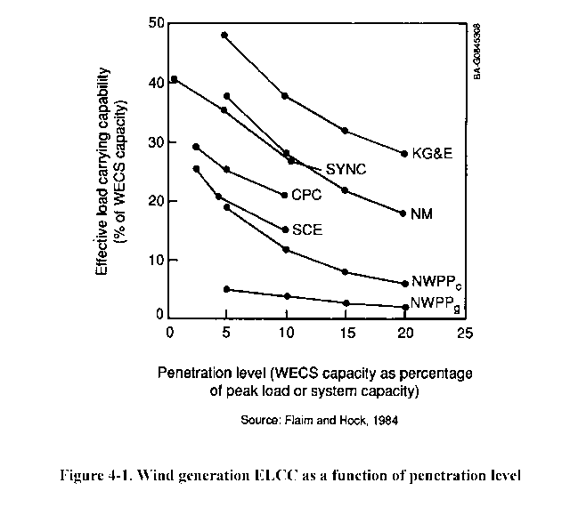
Theoretical Basis (con’t)
Early studies (1980’s) simulated reliability impacts of wind penetration
  At low penetrations, wind can contribute to system reliability
  At higher penetrations, capacity credits decline
Notes:
This chart shows how the capacity credit for a wind generator decreases with increasing market penetration.
This relationship not only captures much of the imbalance and ancillary service costs, but also has a ready-made hook in NEMS through the capacity credit already assigned to generating capacity.

Slide 8
Model Needs
No “show-stoppers” support limits on intermittent penetration
  Many technical issues have already been addressed
  Reliability issues will reveal themselves through increased market costs
Goal: develop algorithm that reflects bulk of market costs
Notes:
I was unable to find a basis for a firm limit to wind penetration.
The research confirmed my assumption that this limit will be realized by increasing market costs that make wind economics increasingly less attractive at higher levels of penetration.
Not all costs can be completely modeled, but the major cost of providing “back-up” capacity to provide reliability services can be shown in NEMS

Slide 9
Selected Approach
Fixed capacity credit is replaced with variable capacity credit which is a function of intermittent penetration
Approach allows higher penetration of intermittent capacity, but requires increasing investment in “back-up” capacity
  Higher penetration levels imply close to 1:1 back-up for each MW of wind
  Intermittents effectively become “fuel-saver”
Notes:
I decided to replace the fixed capacity credit for wind, which you will recall had been set at 75% of peak-load capacity factor, with a capacity credit that decayed with increasing penetration of wind, as shown a couple of slides ago.
This approach will essentially require the model to purchase increasing amounts of “back-up” capacity as wind penetration increases to ensure reliable grid operations.
At very high penetrations, the model will effectively have to buy one megwatt of “firm” capacity for every megawatt of wind capacity, turning wind into a fuel-saver that cannot provide incremental contribution to grid capacity.

Slide 10
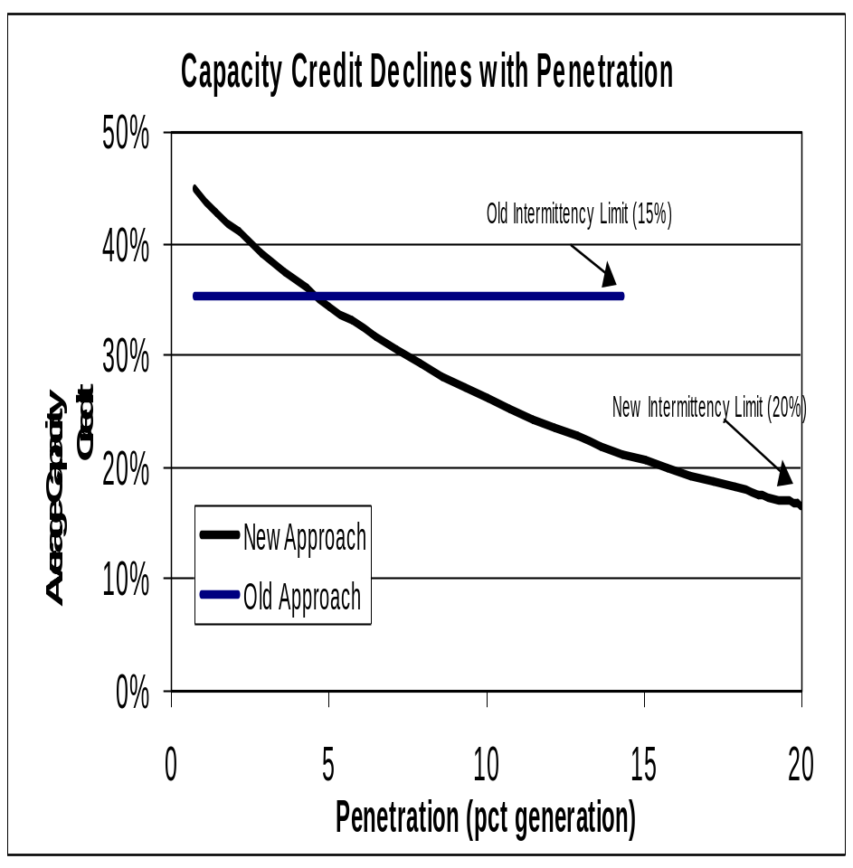
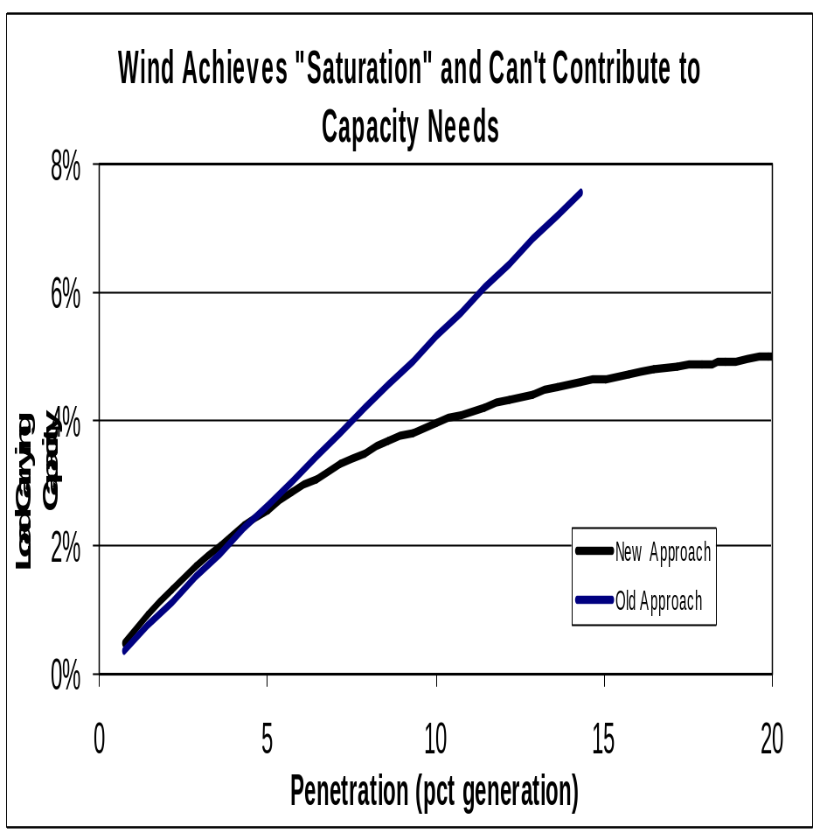
How it Looks
Notes:
On the left figure, you see the straight line which represents the AEO2002 capacity credit for wind in a typical wind region.
This line stays flat at 75% of the peak-load capacity factor of 45% until it hits the 15% limit- Note that this is somewhat higher than the annual capacity factor, which is probably closer to 33% since in this region the wind tends to blow during peak load
The other line shows how in AEO2003 the capacity credit decays with increasing penetration.
Initially, it provides a more favorable capacity credit for wind, but at a relatively modest penetration, it drops below the old value.
The figure on the right shows that the wind can’t contribute any more “effective load carrying capacity” to the grid at higher penetration levels.
Thus it reaches a saturation point at which contribution to reserve margin does not increase with increasing market share

Slide 11
Open Issues
Need additional analysis to develop better parameters
  Parameters may need to vary by region
Intermittency limit retained at 20%
  Does not account for “surplus” production off-peak
  At >20% of generation, wind can potentially disrupt coal and nuclear operations
Notes:
The 15-year old studies that this approach is based off of do not address effects on the large, NERC regions modeled in NEMS.
Presumably, effects such as geographic dispersion of the wind and larger reserve pools will affect the parameters that need to be used.
In some very high penetration cases I found that wind penetration above 20% started to cause coal plants to cycle to very low levels, and threatened to cause nuclear plants to cycle during the very low load periods. Cycling in this case refers to a plant shutting down and restarting, which can be very expensive for coal, and expensive and dangerous for nuclear.
I am currently developing an approach to incorporate this cost into the model, but in the interim have retained an intermittency limit of 20% to ensure a very conservative accounting for this cost.

Slide 12
Cost Decline: Background
Although wind capital cost experience curve was initially steep, little apparent movement over past 5+ years.
  Timeframe represents major growth spurt for wind
Declines in levelized cost mostly attributable to performance improvement
Notes:
The second major change concerns how improvements in the cost of wind are modeled.
Historical evidence shows that once initial capital cost declines for wind were achieved, they have declined very little over a period of very strong growth in the wind markets.
The cost of energy from wind has apparently declined, however.
This decline is attributable to the improvement in performance of wind turbines with increasing experience.

Slide 13
AEO2002 Approach
Wind classified as “evolutionary” technology in NEMS learning function
  95% progress ratio (5% cost decline for each doubling of capacity)
  20% minimum cost decline by 2020, growth independent
Wind capacity factor fixed according to year
  42% in Class 6 (best wind resource) for most of forecast period
  Does not vary, even in high penetration scenarios
Notes:
AEO2002 had been giving wind a significant, learning-based decline in capital cost, with a significant “minimum” decline by 2020.
The performance of wind is measured by the annual capacity factor. In AEO2002 it increased somewhat early in the forecast, but was assumed to remain constant through most of the forecast period.
Most importantly, improvement in wind capacity factor did not vary, regardless of how much growth was seen in the wind market.

Slide 14
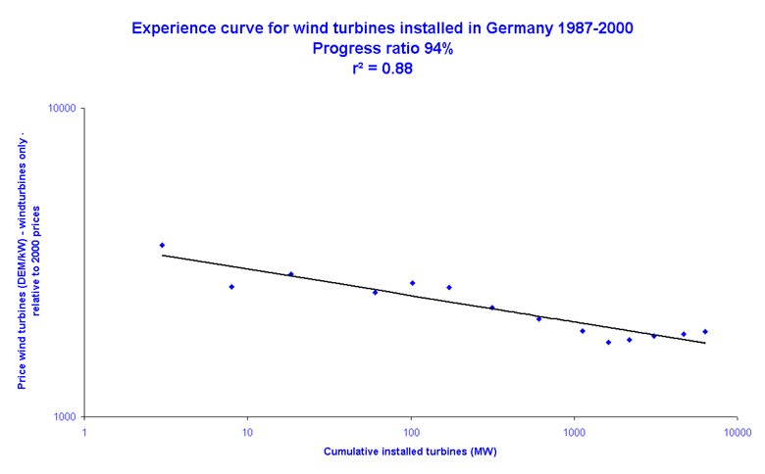
Experience Curve Shows Overall Decline, Increases in Last 5-10 Years
Notes:
Reliable capital cost data for U.S. is not available. Studies of the “experience curve” for wind capital cost have been done in Europe. The figure shows one such study for Germany
The overall progress ratio is very good, but has stagnated or even increased a little bit over the past 10 years.
Anecdotal evidence suggests that this also applies to the U.S. market, with a very stable cost of around $1000 per kilowatt over the past 5 to 10 years.

Slide 15
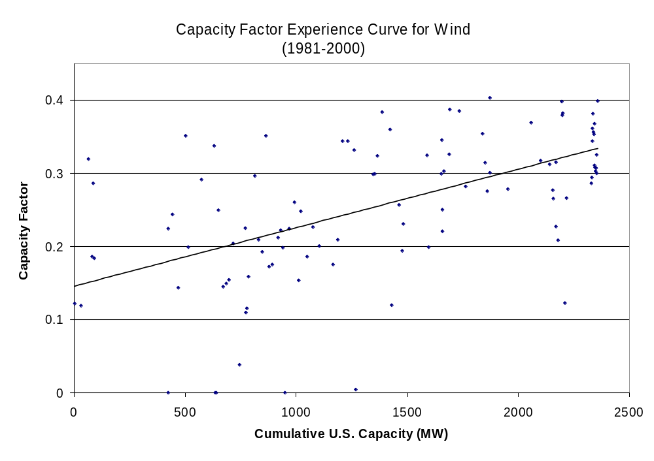
Performance Shows Continued Improvement
Notes:
EIA does collect output data for wind generation.
Analysis is complicated by site-specific and turbine-specific differences, but a generally increasing trend can be seen on the right-hand figure.

Slide 16
Revised AEO2003 Approach
Learning function parameters for wind reclassified from “evolutionary” (95% progress ratio) to “conventional” (99% progress ratio)
  Minimum capital cost learning effectively eliminated
Capacity factors “learn” with experience
  Maximum set at 45% (AEO2003 achieves 42%)
  Class 4 & 5 winds based on Class 6 value
  Improvement is now dynamic and improves more in higher penetration scenarios
Notes:
NEMS was showing the converse of the historical trend with steeply declining capital costs and stable performance, not stable capital costs with improving performance.
For AEO2003, I adjusted the parameters in the “learning curve” function for wind to minimize capital cost improvements.
I also made the improvement in capacity factor dynamic, to respond to “learning” effects with increasing market growth.
The capacity factor improvement is now bigger in scenarios where more experience with wind is gained.

Slide 17
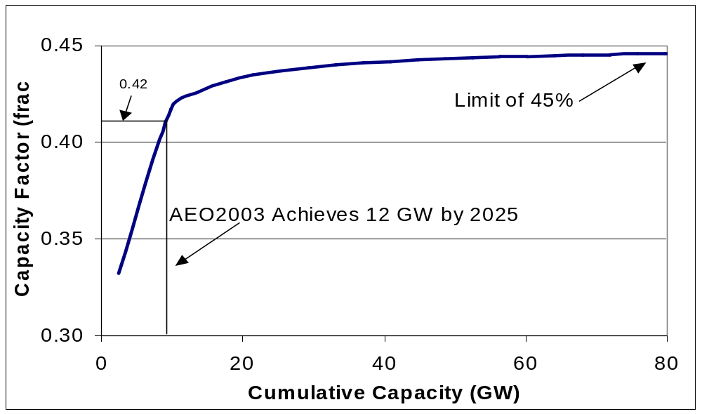
AEO2003 Achieves Capacity Factor of 42%
Notes:
The model can still allow the user to specify an arbitrary path for capacity factor improvement.
Capacity factor is for new units built by model, existing units maintain historical capacity factor
This allows us to adopt the DOE wind program office’s assumptions for year-specific capacity factor when running our High Renewables case in the AEO.

Slide 18
Open Issues
Model could more explicitly account for factors that could improve performance
  Rotor diameters and tower height
  Improved resource characterization
  Better design
Not enough data or understanding to allow further improvement of approach

Slide 19
END

Slide 20
Developing a Theoretical Basis
Penetration levels at which effect is beyond any present-day system
  Denmark has high wind penetration, but is not a “stand-alone” reliability region, such as an EMM region
  Wind is approx. 15% of Danish generation, but only 1-2% of NORDEL (the Scandinavian equivalent to a NERC region)
Actual effects are thus not yet known

Slide 21
Theoretical Basis (con’t)
Recent work has focused on cost of ancillary services for wind-induced system imbalances
  Without “penalties”, marginal imbalance/ regulation costs tend toward net zero
  With unbiased generation forecasting, output is equally likely to be “short” or “long”
  Costs ultimately reflect the addition of “firm” capacity to ensure market liquidity/adequate reserve

Slide 22
Theoretical Basis (con’t)
3 ISO/RTO’s have actual “capacity markets”
  PJM does not allow intermittent resources to compete in capacity market
  NYISO and New England ISO allow intermittent resources using average annual capacity factor to de-rate capacity
FERC prefers markets that do not impose “arbitrary” penalties on intermittents

Slide 23
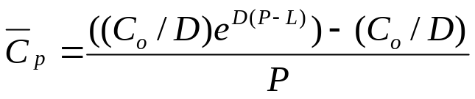
Revised Approach: Details
Where:
C_{p} is the average capacity credit at a penetration level of P and C₀ is the initial capacity credit at zero penetration
e is the base of the natural logarithm
P is the fraction of total intermittent generation across all generation for the region in the previous calendar year
L is an “offset” factor (not currently used)
D, the exponential decay factor, is calculated from:
D=-ln(2)/H
Where H is the “half-life” parameter for the function

